Slide 1

Oral Report

Slide 2
Task Distribution & Progress
Data Collection & Cleaning – ✔ Completed
Visualization Design – ✔ Completed
Interactivity Features – ⏳ In Progress
Testing & Debugging – ⏳ Ongoing
Report Writing – 📝 Drafting Methodology & Challenges
Notes:
Hello everyone, my name is Kim, and this is a quick overview of our team’s progress for Assignment 3B – the Project Process Book. So far, we’ve made solid progress. We’ve completed the data preparation phase and designed the core visualization using D3.js. Our next major focus is adding interactivity, like tooltips and hover effects, which are currently in progress. We’ve distributed tasks evenly: I worked on the data integration and supported the D3.js implementation, while others focused on report writing and debugging.

Slide 3
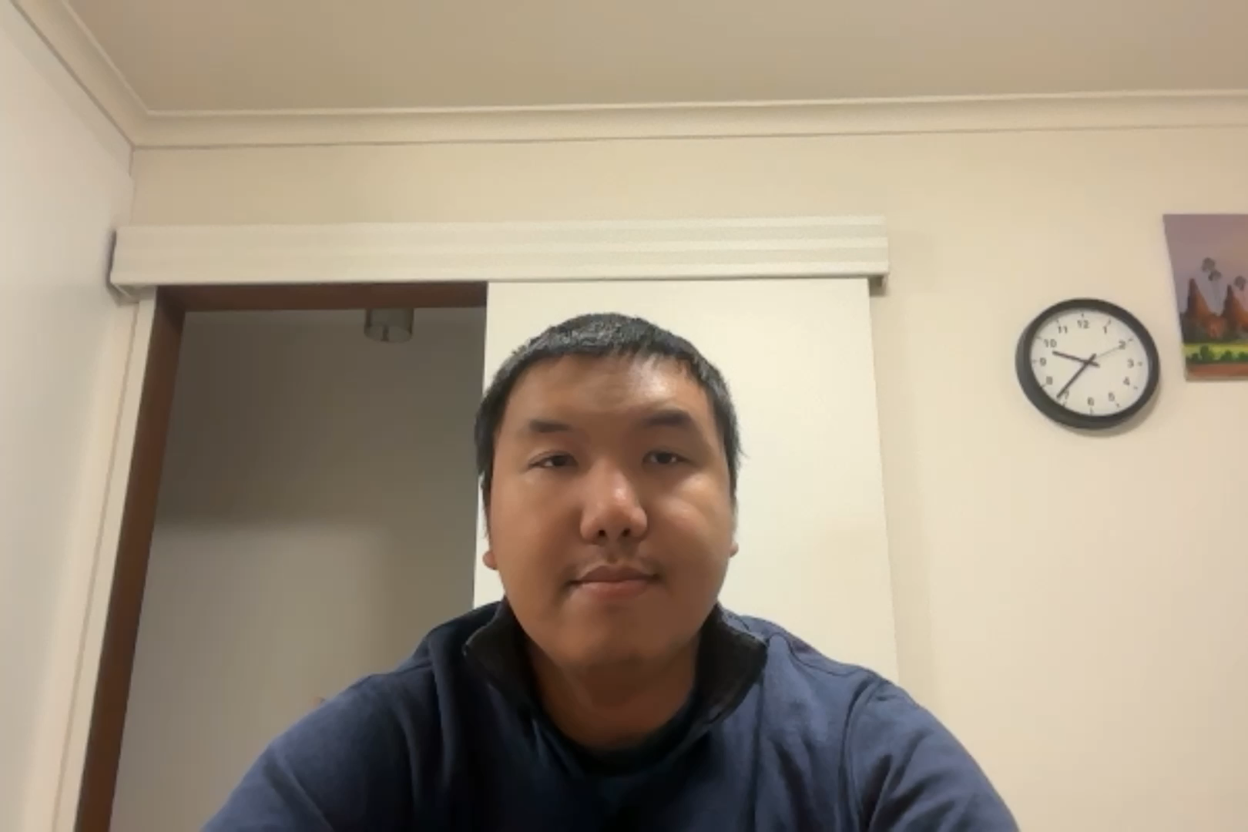
Challenges Faced
Time Management: Clash with other unit deadlines
Technical Issues: Mobile rendering bugs in D3.js
Data Complexity: Parsing OECD dataset accurately

